Slide 1
Chapter 9
High Level Language

Slide 2
Usage Notice
You are welcome to use this presentation, or any part of it, in Nand to Tetris courses, or in other courses, as you see fit.
Usage is free for instruction in educational, non-profit settings.
For permission to use the materials in other settings, contact schocken@gmail.com
You can use the slides as-is, or modify them as needed.
We’ll appreciate it if you will credit Nand to Tetris somewhere, and put a reference to www.nand2tetris.org
To stay in touch with our course team about updates and new teaching materials, fill in this form.
Happy teaching!
Shimon Schocken / Noam Nisan

Slide 3
Nand to Tetris Roadmap
software hierarchy
human
abstraction
thought
program
high-level language
abstraction
compiler
VM code
abstraction
OS
VM translator
machine language
assembler
abstraction
hardware platform
computer
abstraction
computer
ALU, RAM
abstraction
chips
elementary logic gates
Nand
gates

Slide 4

Nand to Tetris Roadmap: Part II
software hierarchy
human
abstraction
thought
program
high-level language
abstraction
compiler
VM code
abstraction
OS
VM translator
machine language
assembler

Slide 5
Nand to Tetris Roadmap: Part II
p9
software hierarchy
human
Writing a
abstraction
p10
p11
thought
program
high-level language
Building a
abstraction
p7
p8
compiler
VM code
Building a
abstraction
OS
VM translator
machine language
p12
assembler
Work plan
Projects 7,8: VM translator (compiler’s backend)
Projects 10,11: Compiler (compiler’s frontend)
Project 9: High-level language
Project 12: Operating system.

Slide 6
Nand to Tetris Roadmap: Part II
p9
software hierarchy
human
Writing a
abstraction
thought
program
high-level language
Building a
abstraction
compiler
VM code
Building a
abstraction
OS
VM translator
machine language
assembler
Work plan
Projects 7,8: VM translator (compiler’s backend)
Projects 10,11: Compiler (compiler’s frontend)
Project 9: High-level language
Project 12: Operating system.

Slide 7
Nand to Tetris Roadmap: Part II
p9
software hierarchy
human
Writing a
abstraction
thought
program
high-level language
Building a
abstraction
compiler
VM code
Building a
abstraction
OS
VM translator
machine language
assembler
Project 9
Objective: Develop a Jack application
Motivation: Get familiar with the Jack high level language, in order to develop a compiler and OS in projects 10, 11, 12.

Slide 8

The Jack Programming Language
Sorry, we don’t seem to need Jack programmers right now.
Project 9
Objective: Develop a Jack application
Motivation: Get familiar with the Jack high level language, in order to develop a compiler and OS in projects 10, 11, 12.

Slide 9
Take home lessons
An inside view of how high-level OO languages …
are designed
handle primitive types and class types
deal with strings, arrays, and lists
create, represent, and dispose objects
interact with the host OS
Plus, additional experience with ...
Abstraction / implementation
OO programming
Application design and implementation
Optimization.

Slide 10
Lecture plan
High level programming
Program example
Basic language constructs
Object-based programming
List processing
Gives a flavor of the language
Jack language specification
The language
The operating system
Technical reference
Application development
Jack applications
Application example
Optimization.
Relevant to project 9

Slide 11

Jack program example
/** Performs some interaction with the user.*/
class Main {
function void main() {
String s;
int energy, i;
let s = Keyboard.readLine("Whats on your mind?");
let energy = Keyboard.readInt("Whats your energy level?");
let i = 0;
let s = s.appendChar(33); // Appends the character '!'
while (i < energy) {
do Output.printString(s);
do Output.println();
let i = i + 1;
}
return;
}
}
Whats on your mind? GO TIGERS
Whats your energy level? 3
GO TIGERS!
GO TIGERS!
GO TIGERS!
Fraction API

Slide 12
Jack program example
/** Performs some interaction with the user.*/
class Main {
function void main() {
String s;
int energy, i;
let s = Keyboard.readLine("Whats on your mind?");
let energy = Keyboard.readInt("Whats your energy level?");
let i = 0;
let s = s.appendChar(33); // Appends the character '!'
while (i < energy) {
do Output.printString(s);
do Output.println();
let i = i + 1;
}
return;
}
}
Jack:
A simple, Java-like language
Object-based
Multi-purpose
Lends itself to interactive apps
Can be learned in an hour.

Slide 13
Basic language constructs
/** Performs some interaction with the user.*/
class Main {
function void main() {
String s;
int energy, i;
let s = Keyboard.readLine("Whats on your mind?");
let energy = Keyboard.readInt("Whats your energy level?");
let i = 0;
let s = s.appendChar(33); // Appends the character '!'
while (i < energy) {
do Output.printString(s);
do Output.println();
let i = i + 1;
}
return;
}
}

Slide 14
Basic language constructs
/** Performs some interaction with the user.*/
class Main {
function void main() {
String s;
int energy, i;
let s = Keyboard.readLine("Whats on your mind?");
let energy = Keyboard.readInt("Whats your energy level?");
let i = 0;
let s = s.appendChar(33); // Appends the character '!'
while (i < energy) {
do Output.printString(s);
do Output.println();
let i = i + 1;
}
return;
}
}
Comments
// comment to end of line
/* block comment */
/** API block comment */
White space
(ignored)

Slide 15
Basic language constructs
/** Performs some interaction with the user.*/
class Main {
function void main() {
String s;
int energy, i;
let s = Keyboard.readLine("Whats on your mind?");
let energy = Keyboard.readInt("Whats your energy level?");
let i = 0;
let s = s.appendChar(33); // Appends the character '!'
while (i < energy) {
do Output.printString(s);
do Output.println();
let i = i + 1;
}
return;
}
}
Program structure
A Jack program is a collection of one or more Jack classes, one of which must be named Main
The Main class must have at least one function, named main
Program’s entry point: Main.main

Slide 16
Basic language constructs
Data types
Primitive:
int
char
boolean
Class types:
Built-in types, like String
Programmer-defined types: Defined and used as needed.
/** Performs some interaction with the user.*/
class Main {
function void main() {
String s;
int energy, i;
let s = Keyboard.readLine("Whats on your mind?");
let energy = Keyboard.readInt("Whats your energy level?");
let i = 0;
let s = s.appendChar(33); // Appends the character '!'
while (i < energy) {
do Output.printString(s);
do Output.println();
let i = i + 1;
}
return;
}
}

Slide 17
Basic language constructs
/** Performs some interaction with the user.*/
class Main {
function void main() {
String s;
int energy, i;
let s = Keyboard.readLine("Whats on your mind?");
let energy = Keyboard.readInt("Whats your energy level?");
let i = 0;
let s = s.appendChar(33); // Appends the character '!'
while (i < energy) {
do Output.printString(s);
do Output.println();
let i = i + 1;
}
return;
}
}
Flow of control
if
while
do

Slide 18
Basic language constructs
/** Performs some interaction with the user.*/
class Main {
function void main() {
String s;
int energy, i;
let s = Keyboard.readLine("Whats on your mind?");
let energy = Keyboard.readInt("Whats your energy level?");
let i = 0;
let s = s.appendChar(33); // Appends the character '!'
while (i < energy) {
do Output.printString(s);
do Output.println();
let i = i + 1;
}
return;
}
}
Input / output
Keyboard (OS class): A library of functions for reading from the keyboard
Output (OS class): A library of functions for writing to the screen

Slide 19

Lecture plan
High level programming
Program example
Basic language constructs
Object-based programming
List processing
Gives a flavor of the language
Jack language specification
The language
The operating system
Application development
Jack applications
Application example
Graphics optimization

Slide 20
Basic language constructs
/** Performs some interaction with the user.*/
class Main {
function void main() {
String s;
int energy, i;
let s = Keyboard.readLine("Whats on your mind?");
let energy = Keyboard.readInt("Whats your energy level?");
let i = 0;
let s = s.appendChar(33); // Appends the character '!'
while (i < energy) {
do Output.printString(s);
do Output.println();
let i = i + 1;
}
return;
}
}
Simple program:
Procedural
One class / one function
No objects

Slide 21
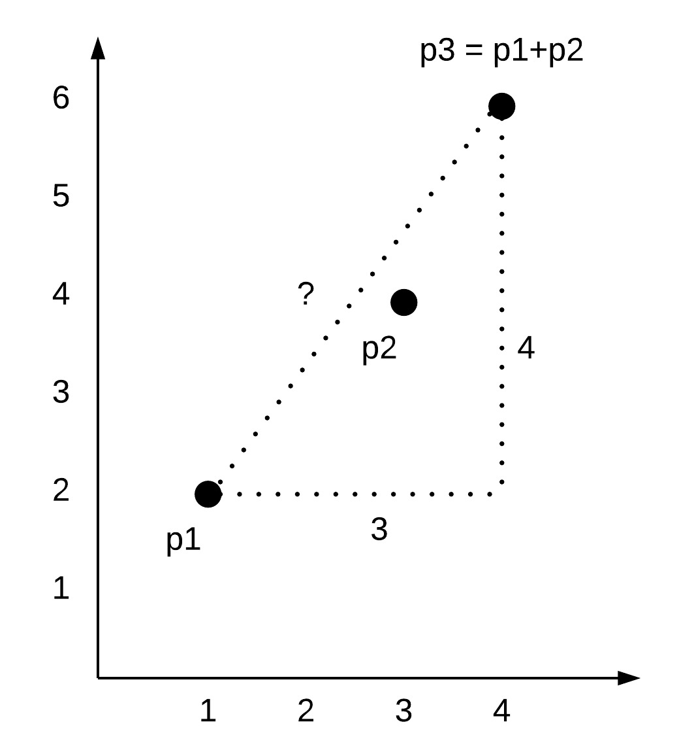
Object oriented programming
Example
We wish to represent and manipulate points in a two-dimensional plane.
Examples (typical program outputs):
(1,2) + (3,4) = (4,6) // Vector addition
Distance betw. (1,2) and (4,6)) is 5 // Euclidean distance
...
Object oriented solution:
Represent point as a data structure consisting of two int values (the point coordinates),
Write a Jack class designed to represent and manipulate such data structures.

Slide 22
OO Programming
Point class API
/** Represents a point in 2D plane. */
class Point {
/** Constructs a point from the given coordinates */
constructor Point new(int ax, int ay)
/** Returns the number of points constructed so far */
function int getPointCount()
/** Returns the sum of this point and the other point */
method Point plus(Point other)
/** Returns the Euclidean distance between this point and the other point */
method int distance(Point other)
/** Prints this point, as "(x,y)" */
method void print() {
// More Point methods…
}
Provides services for constructing and manipulating Point objects
Let’s open the black box…
This code uses the services of the Point class. It can appear in any Jack class.
Client code
...
var Point p1, p2, p3;
let p1 = Point.new(1,2);
let p2 = Point.new(3,4);
let p3 = p1.plus(p2);
do p3.print(); // prints (4,6)
do Output.printInt(p1.distance(p2)); // prints 5
do Output.printInt(getPointCount()); // prints 3
...
Here we view the Point class as an abstraction
The API specifies the class functionality, without describing how it delivers this functionality.
That’s all that clients need to know.

Slide 23
OO Programming
Point class
A Jack class:
Consists of field declarations, static variable declarations, and subroutine declarations (constructors, methods, functions)
All fields and static variables are private
All subroutines are public
The only way to get access to a field or a static (from outside the class) is by calling an accessor method (like getx, gety, …)
/** Represents a point in 2D plane. */
class Point {
// The coordinates of this point:
field int x, y
// The number of point objects constructed so far:
static int pointCount;
/** Constructs a point and initializes it with the given coordinates */
constructor Point new(int ax, int ay) {
let x = ax;
let y = ay;
let pointCount = pointCount + 1;
return this;
}
/** Returns the x coordinate of this point */
method int getx() { return x; }
/** Returns the y coordinate of this point */
method int gety() { return y; }
/** Returns the number of points constructed so far */
function int getPointCount() {
return pointCount;
}
// More Point methods…
Fields: Object properties
Statics: Class variables
Constructors:
Create and initialize objects.
A Jack class has 0 or more constructors. One of them is normally named new.
Methods:
Operate on the current object
Functions:
Static methods that operate on no particular object

Slide 24
OO Programming: Creating objects
Point class
/** Represents a point in 2D plane. */
class Point {
// The coordinates of this point:
field int x, y
// The number of point objects constructed so far:
static int pointCount;
/** Constructs a point and initializes it with the given coordinates */
constructor Point new(int ax, int ay) {
let x = ax;
let y = ay;
let pointCount = pointCount + 1;
return this;
}
// More Point methods…
A peek under the hood:
Jack programmers treat objects as abstractions
We will now preview how the object abstraction is actually implemented
This implementation will be realized when we’ll build the Jack compiler and operating system.
Client code
...
var Point p1, p2;
let p1 = Point.new(1,2);
let p2 = Point.new(3,4);
...

Slide 25
OO Programming: Creating objects
Point class
RAM
/** Represents a point in 2D plane. */
class Point {
// The coordinates of this point:
field int x, y
// The number of point objects constructed so far:
static int pointCount;
/** Constructs a point and initializes it with the given coordinates */
constructor Point new(int ax, int ay) {
let x = ax;
let y = ay;
let pointCount = pointCount + 1;
return this;
}
// More Point methods…
0
. . .
Static variables
. . .
256
. . .
Local and argument variables of executing subroutines
stack
. . .
2047
2048
. . .
Client code
...
var Point p1, p2;
let p1 = Point.new(1,2);
let p2 = Point.new(3,4);
...
Objects and arrays
heap
. . .

Slide 26
OO Programming: Creating objects
Point class
RAM
/** Represents a point in 2D plane. */
class Point {
// The coordinates of this point:
field int x, y
// The number of point objects constructed so far:
static int pointCount;
/** Constructs a point and initializes it with the given coordinates */
constructor Point new(int ax, int ay) {
let x = ax;
let y = ay;
let pointCount = pointCount + 1;
return this;
}
// More Point methods…
0
. . .
16
2
pointCount
Static variables
. . .
256
. . .
15087
p1
Local and argument variables of executing subroutines
(arbitrary addresses)
stack
4112
p2
. . .
2047
2048
. . .
Client code
4112
1
...
var Point p1, p2;
let p1 = Point.new(1,2);
let p2 = Point.new(3,4);
...
4113
2
Objects and arrays
. . .
heap
15087
3
15088
4
. . .
. . .

Slide 27
OO Programming: Creating objects
Point class
RAM
/** Represents a point in 2D plane. */
class Point {
// The coordinates of this point:
field int x, y
// The number of point objects constructed so far:
static int pointCount;
/** Constructs a point and initializes it with the given coordinates */
constructor Point new(int ax, int ay) {
let x = ax;
let y = ay;
let pointCount = pointCount + 1;
return this;
}
// More Point methods…
0
. . .
16
2
pointCount
. . .
As we will see when we’ll write the Jack compiler, the compiled constructor’s code (not shown here) calls an OS function that allocates a RAM block for representing the new object
Next, the compiled constructor code assigns the base address of the allocated block to the object variable this
And… each constructor must end with the statement return this
256
. . .
15087
p1
(arbitrary addresses)
stack
4112
p2
. . .
2047
2048
. . .
Client code
4112
1
...
var Point p1, p2;
let p1 = Point.new(1,2);
let p2 = Point.new(3,4);
...
4113
2
. . .
heap
This explains how the client-side object variables (like p1 and p2) end up pointing to the objects returned by the constructor.
15087
3
15088
4
. . .
. . .

Slide 28
OO Programming
Point class (complete class code)
/** Represents a point in 2D plane.
File name: Point.jack. */
class Point {
// The coordinates of this point:
field int x, y
// The number of point objects constructed so far:
static int pointCount;
/** Constructs a point and initializes it with the given coordinates */
constructor Point new(int ax, int ay) {
let x = ax;
let y = ay;
let pointCount = pointCount + 1;
return this;
}
/** Returns the x coordinate of this point */
method int getx() { return x; }
/** Returns the y coordinate of this point */
method int gety() { return y; }
/** Returns the number of Points constructed so far */
function int getPointCount() {
return pointCount;
}
// Class declaration continues on top right.
/** Returns a point which is this point plus the other point */
method Point plus(Point other) {
return Point.new(x + other.getx(),
y + other.gety());
}
/** Returns the Euclidean distance between
this point and the other point */
method int distance(Point other) {
var int dx, dy;
let dx = x – other.getx();
let dy = y – other.gety();
return Math.sqrt((dx*dx) + (dy*dy));
}
/** Prints this point, as "(x,y)" */
method void print() {
do Output.printString("(");
do Output.printInt(x);
do Output.printString(",");
do Output.printInt(y);
do Output.printString(")");
return;
}
// More Point methods…
} // End of Point class declaration.
Client code
...
var Point p1, p2, p3;
let p1 = Point.new(1,2);
let p2 = Point.new(3,4);
let p3 = p1.plus(p2);
do p3.print(); // prints (4,6)
do Output.printInt(p1.distance(p2)); // prints 5
do Output.printInt(getPointCount()); // prints 3
...

Slide 29
OO Programming
Point class – one more detail
/** Represents a point in 2D plane.
File name: Point.jack. */
class Point {
// The coordinates of this point:
field int x, y
// The number of point objects constructed so far:
static int pointCount;
/** Constructs a point and initializes it with the given coordinates */
constructor Point new(int ax, int ay) {
let x = ax;
let y = ay;
let pointCount = pointCount + 1;
return this;
}
// All the Point subroutines we saw before, and:
/** Disposes this point. */
method void dispose() {

Slide 30
OO Programming
Point class – one more detail
/** Represents a point in 2D plane.
File name: Point.jack. */
class Point {
// The coordinates of this point:
field int x, y
// The number of point objects constructed so far:
static int pointCount;
/** Constructs a point and initializes it with the given coordinates */
constructor Point new(int ax, int ay) {
let x = ax;
let y = ay;
let pointCount = pointCount + 1;
return this;
}
// All the Point subroutines we saw before, and:
/** Disposes this point. */
method void dispose() {
// Calls an OS function to free the memory
// of this object
do Memory.deAlloc(this);.
return;
}
}
Note:
Jack has no garbage collection
Objects must be disposed explicitly
Best practice
If you write a class that has a constructor, write also a dispose method
When an object is no longer needed, dispose it.
Client code
...
var Point p1;
let p1 = Point.new(1,2);
...
// When the object is no longer needed:
do p1.dispose();
...
An OS method that frees the memory space allocated to the given object

Slide 31
Lecture plan
High level programming
Program example
Basic language constructs
Object-based programming
List processing
Gives a flavor of the language
Jack language specification
The language
The operating system
Application development
Jack applications
Application example
Graphics optimization

Slide 32
List processing
List:
The atom null, or
An atom, followed by a list
List examples:
null
(5, null)
(3, (5, null))
(2, (3, (5, null)))
Abbreviated as:
()
(5)
(3, 5)
(2, 3, 5)
data next
data next
data next
v
2
3
5
Example: the list v = (2, (3, (5, null))), commonly abbreviated as (2, 3, 5)

Slide 33
List processing
List class API
Client code
/** Represents a linked list of integers. */
class List {
/** Creates a List */
constructor List new(int car, List cdr)
/** Prints this list */
method void print() {
/** Disposes this list */
method void dispose() {
// More list processing methods
}
// Builds, prints, and disposes a list
class Main {
function void main() {
// Creates the list (2,3,5)
var List v;
let v = List.new(5,null);
let v = List.new(3,v));
let v = List.new(2,v));
do v.print(); // prints (2, 3, 5)
do v.dispose(); // disposes the list
return;
}
}
Let’s open the black box…
data next
data next
data next
v
2
3
5
Example: the list v = (2, (3, (5, null))), commonly abbreviated as (2, 3, 5)

Slide 34
List processing: Creation
List class
Client code
/** Represents a linked list of integers. */
class List {
field int data; // a list consists of a data field,
field List next; // followed by a list.
/* Creates a List. */
constructor List new(int car, List cdr) {
let data = car;
let next = cdr;
return this;
}
// More List methods
}
...
var List v;
let v = List.new(5,null);
let v = List.new(3, v));
let v = List.new(2, v));
...

Slide 35
List processing: Creation
List class
Client code
/** Represents a linked list of integers. */
class List {
field int data; // a list consists of a data field,
field List next; // followed by a list.
/* Creates a List. */
constructor List new(int car, List cdr) {
let data = car;
let next = cdr;
return this;
}
// More List methods
}
...
var List v;
let v = List.new(5,null);
let v = List.new(3, v));
let v = List.new(2, v));
...
v
(null)

Slide 36
List processing: Creation
List class
Client code
/** Represents a linked list of integers. */
class List {
field int data; // a list consists of a data field,
field List next; // followed by a list.
/* Creates a List. */
constructor List new(int car, List cdr) {
let data = car;
let next = cdr;
return this;
}
// More List methods
}
...
var List v;
let v = List.new(5,null);
let v = List.new(3, v));
let v = List.new(2, v));
...
v
(null)

Slide 37
List processing: Creation
List class
Client code
/** Represents a linked list of integers. */
class List {
field int data; // a list consists of a data field,
field List next; // followed by a list.
/* Creates a List. */
constructor List new(int car, List cdr) {
let data = car;
let next = cdr;
return this;
}
// More List methods
}
...
var List v;
let v = List.new(5,null);
let v = List.new(3, v));
let v = List.new(2, v));
...
data next
v
5

Slide 38
List processing: Creation
List class
Client code
/** Represents a linked list of integers. */
class List {
field int data; // a list consists of a data field,
field List next; // followed by a list.
/* Creates a List. */
constructor List new(int car, List cdr) {
let data = car;
let next = cdr;
return this;
}
// More List methods
}
...
var List v;
let v = List.new(5,null);
let v = List.new(3, v));
let v = List.new(2, v));
...
data next
v
5

Slide 39
List processing: Creation
List class
Client code
/** Represents a linked list of integers. */
class List {
field int data; // a list consists of a data field,
field List next; // followed by a list.
/* Creates a List. */
constructor List new(int car, List cdr) {
let data = car;
let next = cdr;
return this;
}
// More List methods
}
...
var List v;
let v = List.new(5,null);
let v = List.new(3, v));
let v = List.new(2, v));
...
data next
data next
v
3
5

Slide 40
List processing: Creation
List class
Client code
/** Represents a linked list of integers. */
class List {
field int data; // a list consists of a data field,
field List next; // followed by a list.
/* Creates a List. */
constructor List new(int car, List cdr) {
let data = car;
let next = cdr;
return this;
}
// More List methods
}
...
var List v;
let v = List.new(5,null);
let v = List.new(3, v));
let v = List.new(2, v));
...
data next
data next
v
3
5

Slide 41
List processing: Creation
List class
Client code
/** Represents a linked list of integers. */
class List {
field int data; // a list consists of a data field,
field List next; // followed by a list.
/* Creates a List. */
constructor List new(int car, List cdr) {
let data = car;
let next = cdr;
return this;
}
// More List methods
}
...
var List v;
let v = List.new(5,null);
let v = List.new(3, v));
let v = List.new(2, v));
...
data next
data next
data next
v
2
3
5

Slide 42
List processing: Creation
List class
Client code
/** Represents a linked list of integers. */
class List {
field int data; // a list consists of a data field,
field List next; // followed by a list.
/* Creates a List. */
constructor List new(int car, List cdr) {
let data = car;
let next = cdr;
return this;
}
// More List methods
}
...
var List v;
let v = List.new(5,null);
let v = List.new(3, v));
let v = List.new(2, v));
...
Same as:
var List v;
let v = List.new(2,List.new(3,List.new(5,null)));
data next
data next
data next
v
2
3
5

Slide 43
List processing: Sequential access
List class
Client code
/** Represents a linked list of integers. */
class List {
field int data; // a list consists of a data field,
field List next; // followed by a list.
// The constructor (code omitted)
/** Prints this list */
method void print() {
var List current; // creates a List variable and
let current = this; // initializes it to the first item of this list
while (~(current = null)) {
do Output.printInt(current.getData());
do Output.printChar(32); // prints a space
do current = current.getNext();
}
return;
}
// More list methods…
var List v;
// builds the list v = (2, 3, 5)
// (code not shown)
...
do v.print();
...
2 3 5
data next
data next
data next
v
2
3
5

Slide 44
List processing: Sequential access
List class
Client code
/** Represents a linked list of integers. */
class List {
field int data; // a list consists of a data field,
field List next; // followed by a list.
// The constructor (code omitted)
/** Prints this list */
method void print() {
var List current; // creates a List variable and
let current = this; // initializes it to the first item of this list
while (~(current = null)) {
do Output.printInt(current.getData());
do Output.printChar(32); // prints a space
do current = current.getNext();
}
return;
}
// More list methods…
var List v;
// builds the list v = (2, 3, 5)
// (code not shown)
...
do v.print();
...
data next
data next
data next
v
2
3
5

Slide 45
List processing: Sequential access
List class
Client code
/** Represents a linked list of integers. */
class List {
field int data; // a list consists of a data field,
field List next; // followed by a list.
// The constructor (code omitted)
/** Prints this list */
method void print() {
var List current; // creates a List variable and
let current = this; // initializes it to the first item of this list
while (~(current = null)) {
do Output.printInt(current.getData());
do Output.printChar(32); // prints a space
do current = current.getNext();
}
return;
}
// More list methods…
var List v;
// builds the list v = (2, 3, 5)
// (code not shown)
...
do v.print();
...
data next
data next
data next
this
2
3
5

Slide 46
List processing: Sequential access
List class
Client code
/** Represents a linked list of integers. */
class List {
field int data; // a list consists of a data field,
field List next; // followed by a list.
// The constructor (code omitted)
/** Prints this list */
method void print() {
var List current; // creates a List variable and
let current = this; // initializes it to the first item of this list
while (~(current = null)) {
do Output.printInt(current.getData());
do Output.printChar(32); // prints a space
do current = current.getNext();
}
return;
}
// More list methods…
var List v;
// builds the list v = (2, 3, 5)
// (code not shown)
...
do v.print();
...
data next
data next
data next
this
2
3
5

Slide 47
List processing: Sequential access
List class
Client code
/** Represents a linked list of integers. */
class List {
field int data; // a list consists of a data field,
field List next; // followed by a list.
// The constructor (code omitted)
/** Prints this list */
method void print() {
var List current; // creates a List variable and
let current = this; // initializes it to the first item of this list
while (~(current = null)) {
do Output.printInt(current.getData());
do Output.printChar(32); // prints a space
do current = current.getNext();
}
return;
}
// More list methods…
var List v;
// builds the list v = (2, 3, 5)
// (code not shown)
...
do v.print();
...
current
data next
data next
data next
this
2
3
5

Slide 48
List processing: Sequential access
List class
Client code
/** Represents a linked list of integers. */
class List {
field int data; // a list consists of a data field,
field List next; // followed by a list.
// The constructor (code omitted)
/** Prints this list */
method void print() {
var List current; // creates a List variable and
let current = this; // initializes it to the first item of this list
while (~(current = null)) {
do Output.printInt(current.getData());
do Output.printChar(32); // prints a space
do current = current.getNext();
}
return;
}
// More list methods…
var List v;
// builds the list v = (2, 3, 5)
// (code not shown)
...
do v.print();
...
current
data next
data next
data next
this
2
3
5

Slide 49
List processing: Sequential access
List class
Client code
/** Represents a linked list of integers. */
class List {
field int data; // a list consists of a data field,
field List next; // followed by a list.
// The constructor (code omitted)
/** Prints this list */
method void print() {
var List current; // creates a List variable and
let current = this; // initializes it to the first item of this list
while (~(current = null)) {
do Output.printInt(current.getData());
do Output.printChar(32); // prints a space
do current = current.getNext();
}
return;
}
// More list methods…
var List v;
// builds the list v = (2, 3, 5)
// (code not shown)
...
do v.print();
...
current
data next
data next
data next
this
2
3
5

Slide 50
List processing: Sequential access
List class
Client code
/** Represents a linked list of integers. */
class List {
field int data; // a list consists of a data field,
field List next; // followed by a list.
// The constructor (code omitted)
/** Prints this list */
method void print() {
var List current; // creates a List variable and
let current = this; // initializes it to the first item of this list
while (~(current = null)) {
do Output.printInt(current.getData());
do Output.printChar(32); // prints a space
do current = current.getNext();
}
return;
}
// More list methods…
var List v;
// builds the list v = (2, 3, 5)
// (code not shown)
...
do v.print();
...
2
current
data next
data next
data next
this
2
3
5

Slide 51
List processing: Sequential access
List class
Client code
/** Represents a linked list of integers. */
class List {
field int data; // a list consists of a data field,
field List next; // followed by a list.
// The constructor (code omitted)
/** Prints this list */
method void print() {
var List current; // creates a List variable and
let current = this; // initializes it to the first item of this list
while (~(current = null)) {
do Output.printInt(current.getData());
do Output.printChar(32); // prints a space
do current = current.getNext();
}
return;
}
// More list methods…
var List v;
// builds the list v = (2, 3, 5)
// (code not shown)
...
do v.print();
...
2
current
data next
data next
data next
this
2
3
5

Slide 52
List processing: Sequential access
List class
Client code
/** Represents a linked list of integers. */
class List {
field int data; // a list consists of a data field,
field List next; // followed by a list.
// The constructor (code omitted)
/** Prints this list */
method void print() {
var List current; // creates a List variable and
let current = this; // initializes it to the first item of this list
while (~(current = null)) {
do Output.printInt(current.getData());
do Output.printChar(32); // prints a space
do current = current.getNext();
}
return;
}
// More list methods…
var List v;
// builds the list v = (2, 3, 5)
// (code not shown)
...
do v.print();
...
2
current
data next
data next
data next
this
2
3
5

Slide 53
List processing: Sequential access
List class
Client code
/** Represents a linked list of integers. */
class List {
field int data; // a list consists of a data field,
field List next; // followed by a list.
// The constructor (code omitted)
/** Prints this list */
method void print() {
var List current; // creates a List variable and
let current = this; // initializes it to the first item of this list
while (~(current = null)) {
do Output.printInt(current.getData());
do Output.printChar(32); // prints a space
do current = current.getNext();
}
return;
}
// More list methods…
var List v;
// builds the list v = (2, 3, 5)
// (code not shown)
...
do v.print();
...
2
current
data next
data next
data next
this
2
3
5

Slide 54
List processing: Sequential access
List class
Client code
/** Represents a linked list of integers. */
class List {
field int data; // a list consists of a data field,
field List next; // followed by a list.
// The constructor (code omitted)
/** Prints this list */
method void print() {
var List current; // creates a List variable and
let current = this; // initializes it to the first item of this list
while (~(current = null)) {
do Output.printInt(current.getData());
do Output.printChar(32); // prints a space
do current = current.getNext();
}
return;
}
// More list methods…
var List v;
// builds the list v = (2, 3, 5)
// (code not shown)
...
do v.print();
...
2
current
data next
data next
data next
this
2
3
5

Slide 55
List processing: Sequential access
List class
Client code
/** Represents a linked list of integers. */
class List {
field int data; // a list consists of a data field,
field List next; // followed by a list.
// The constructor (code omitted)
/** Prints this list */
method void print() {
var List current; // creates a List variable and
let current = this; // initializes it to the first item of this list
while (~(current = null)) {
do Output.printInt(current.getData());
do Output.printChar(32); // prints a space
do current = current.getNext();
}
return;
}
// More list methods…
var List v;
// builds the list v = (2, 3, 5)
// (code not shown)
...
do v.print();
...
2 3
current
data next
data next
data next
this
2
3
5

Slide 56
List processing: Sequential access
List class
Client code
/** Represents a linked list of integers. */
class List {
field int data; // a list consists of a data field,
field List next; // followed by a list.
// The constructor (code omitted)
/** Prints this list */
method void print() {
var List current; // creates a List variable and
let current = this; // initializes it to the first item of this list
while (~(current = null)) {
do Output.printInt(current.getData());
do Output.printChar(32); // prints a space
do current = current.getNext();
}
return;
}
// More list methods…
var List v;
// builds the list v = (2, 3, 5)
// (code not shown)
...
do v.print();
...
2 3
current
data next
data next
data next
this
2
3
5

Slide 57
List processing: Sequential access
List class
Client code
/** Represents a linked list of integers. */
class List {
field int data; // a list consists of a data field,
field List next; // followed by a list.
// The constructor (code omitted)
/** Prints this list */
method void print() {
var List current; // creates a List variable and
let current = this; // initializes it to the first item of this list
while (~(current = null)) {
do Output.printInt(current.getData());
do Output.printChar(32); // prints a space
do current = current.getNext();
}
return;
}
// More list methods…
var List v;
// builds the list v = (2, 3, 5)
// (code not shown)
...
do v.print();
...
2 3
current
data next
data next
data next
this
2
3
5

Slide 58
List processing: Sequential access
List class
Client code
/** Represents a linked list of integers. */
class List {
field int data; // a list consists of a data field,
field List next; // followed by a list.
// The constructor (code omitted)
/** Prints this list */
method void print() {
var List current; // creates a List variable and
let current = this; // initializes it to the first item of this list
while (~(current = null)) {
do Output.printInt(current.getData());
do Output.printChar(32); // prints a space
do current = current.getNext();
}
return;
}
// More list methods…
var List v;
// builds the list v = (2, 3, 5)
// (code not shown)
...
do v.print();
...
2 3
current
data next
data next
data next
this
2
3
5

Slide 59
List processing: Sequential access
List class
Client code
/** Represents a linked list of integers. */
class List {
field int data; // a list consists of a data field,
field List next; // followed by a list.
// The constructor (code omitted)
/** Prints this list */
method void print() {
var List current; // creates a List variable and
let current = this; // initializes it to the first item of this list
while (~(current = null)) {
do Output.printInt(current.getData());
do Output.printChar(32); // prints a space
do current = current.getNext();
}
return;
}
// More list methods…
var List v;
// builds the list v = (2, 3, 5)
// (code not shown)
...
do v.print();
...
2 3
current
data next
data next
data next
this
2
3
5

Slide 60
List processing: Sequential access
List class
Client code
/** Represents a linked list of integers. */
class List {
field int data; // a list consists of a data field,
field List next; // followed by a list.
// The constructor (code omitted)
/** Prints this list */
method void print() {
var List current; // creates a List variable and
let current = this; // initializes it to the first item of this list
while (~(current = null)) {
do Output.printInt(current.getData());
do Output.printChar(32); // prints a space
do current = current.getNext();
}
return;
}
// More list methods…
var List v;
// builds the list v = (2, 3, 5)
// (code not shown)
...
do v.print();
...
2 3 5
current
data next
data next
data next
this
2
3
5

Slide 61
List processing: Sequential access
List class
Client code
/** Represents a linked list of integers. */
class List {
field int data; // a list consists of a data field,
field List next; // followed by a list.
// The constructor (code omitted)
/** Prints this list */
method void print() {
var List current; // creates a List variable and
let current = this; // initializes it to the first item of this list
while (~(current = null)) {
do Output.printInt(current.getData());
do Output.printChar(32); // prints a space
do current = current.getNext();
}
return;
}
// More list methods…
var List v;
// builds the list v = (2, 3, 5)
// (code not shown)
...
do v.print();
...
2 3 5
current
data next
data next
data next
this
2
3
5

Slide 62
List processing: Sequential access
List class
Client code
/** Represents a linked list of integers. */
class List {
field int data; // a list consists of a data field,
field List next; // followed by a list.
// The constructor (code omitted)
/** Prints this list */
method void print() {
var List current; // creates a List variable and
let current = this; // initializes it to the first item of this list
while (~(current = null)) {
do Output.printInt(current.getData());
do Output.printChar(32); // prints a space
do current = current.getNext();
}
return;
}
// More list methods…
var List v;
// builds the list v = (2, 3, 5)
// (code not shown)
...
do v.print();
...
2 3 5
current
data next
data next
data next
this
2
3
5

Slide 63
List processing: Sequential access
List class
Client code
/** Represents a linked list of integers. */
class List {
field int data; // a list consists of a data field,
field List next; // followed by a list.
// The constructor (code omitted)
/** Prints this list */
method void print() {
var List current; // creates a List variable and
let current = this; // initializes it to the first item of this list
while (~(current = null)) {
do Output.printInt(current.getData());
do Output.printChar(32); // prints a space
do current = current.getNext();
}
return;
}
// More list methods…
var List v;
// builds the list v = (2, 3, 5)
// (code not shown)
...
do v.print();
...
2 3 5
current
data next
data next
data next
this
2
3
5

Slide 64
List processing: Sequential access
List class
Client code
/** Represents a linked list of integers. */
class List {
field int data; // a list consists of a data field,
field List next; // followed by a list.
// The constructor (code omitted)
/** Prints this list */
method void print() {
var List current; // creates a List variable and
let current = this; // initializes it to the first item of this list
while (~(current = null)) {
do Output.printInt(current.getData());
do Output.printChar(32); // prints a space
do current = current.getNext();
}
return;
}
// More list methods…
var List v;
// builds the list v = (2, 3, 5)
// (code not shown)
...
do v.print();
...
2 3 5
current
data next
data next
data next
this
2
3
5

Slide 65
List processing: Sequential access
List class
Client code
/** Represents a linked list of integers. */
class List {
field int data; // a list consists of a data field,
field List next; // followed by a list.
// The constructor (code omitted)
/** Prints this list */
method void print() {
var List current; // creates a List variable and
let current = this; // initializes it to the first item of this list
while (~(current = null)) {
do Output.printInt(current.getData());
do Output.printChar(32); // prints a space
do current = current.getNext();
}
return;
}
// More list methods…
var List v;
// builds the list v = (2, 3, 5)
// (code not shown)
...
do v.print();
...
2 3 5
data next
data next
data next
v
2
3
5

Slide 66
List processing: Recursive access

Slide 67
List processing: Recursive access
List class
Client code
/** Represents a linked list of integers. */
class List {
field int data; // a list consists of a data field,
field List next; // followed by a list.
// Constructor and other List methods (code omitted)
/** Disposes this list */
// by recursively disposing its tail
method void dispose() {
if (~(next = null)) {
do next.dispose();
}
// Uses an OS routine to recycle this list
do Memory.deAlloc(this);
return;
}
}
var List v;
// builds the list (2, 3, 5)
...
do v.dispose();
...
data next
data next
data next
v
2
3
5

Slide 68
List processing: Recursive access
List class
Client code
/** Represents a linked list of integers. */
class List {
field int data; // a list consists of a data field,
field List next; // followed by a list.
// Constructor and other List methods (code omitted)
/** Disposes this list */
// by recursively disposing its tail
method void dispose() {
if (~(next = null)) {
do next.dispose();
}
// Uses an OS routine to recycle this list
do Memory.deAlloc(this);
return;
}
}
var List v;
// builds the list (2, 3, 5)
...
do v.dispose();
...
data next
data next
data next
v
2
3
5

Slide 69
List processing: Recursive access
List class
Client code
/** Represents a linked list of integers. */
class List {
field int data; // a list consists of a data field,
field List next; // followed by a list.
// Constructor and other List methods (code omitted)
/** Disposes this list */
// by recursively disposing its tail
method void dispose() {
if (~(next = null)) {
do next.dispose();
}
// Uses an OS routine to recycle this list
do Memory.deAlloc(this);
return;
}
}
var List v;
// builds the list (2, 3, 5)
...
do v.dispose();
...
return site 0
data next
data next
data next
v
2
3
5

Slide 70
List processing: Recursive access
List class
Client code
/** Represents a linked list of integers. */
class List {
field int data; // a list consists of a data field,
field List next; // followed by a list.
// Constructor and other List methods (code omitted)
/** Disposes this list */
// by recursively disposing its tail
method void dispose() {
if (~(next = null)) {
do next.dispose();
}
// Uses an OS routine to recycle this list
do Memory.deAlloc(this);
return;
}
}
var List v;
// builds the list (2, 3, 5)
...
do v.dispose();
...
return site 0
data next
data next
data next
v
2
3
5

Slide 71
List processing: Recursive access
List class
Client code
/** Represents a linked list of integers. */
class List {
field int data; // a list consists of a data field,
field List next; // followed by a list.
// Constructor and other List methods (code omitted)
/** Disposes this list */
// by recursively disposing its tail
method void dispose() {
if (~(next = null)) {
do next.dispose();
}
// Uses an OS routine to recycle this list
do Memory.deAlloc(this);
return;
}
}
var List v;
// builds the list (2, 3, 5)
...
do v.dispose();
...
return site 0
data next
data next
data next
this
2
3
5

Slide 72
List processing: Recursive access
List class
Client code
/** Represents a linked list of integers. */
class List {
field int data; // a list consists of a data field,
field List next; // followed by a list.
// Constructor and other List methods (code omitted)
/** Disposes this list */
// by recursively disposing its tail
method void dispose() {
if (~(next = null)) {
do next.dispose();
}
// Uses an OS routine to recycle this list
do Memory.deAlloc(this);
return;
}
}
var List v;
// builds the list (2, 3, 5)
...
do v.dispose();
...
return site 0
data next
data next
data next
this
2
3
5

Slide 73
List processing: Recursive access
List class
Client code
/** Represents a linked list of integers. */
class List {
field int data; // a list consists of a data field,
field List next; // followed by a list.
// Constructor and other List methods (code omitted)
/** Disposes this list */
// by recursively disposing its tail
method void dispose() {
if (~(next = null)) {
do next.dispose();
}
// Uses an OS routine to recycle this list
do Memory.deAlloc(this);
return;
}
}
var List v;
// builds the list (2, 3, 5)
...
do v.dispose();
...
return site 0
return site 1
data next
data next
data next
this
2
3
5

Slide 74
List processing: Recursive access
List class
Client code
/** Represents a linked list of integers. */
class List {
field int data; // a list consists of a data field,
field List next; // followed by a list.
// Constructor and other List methods (code omitted)
/** Disposes this list */
// by recursively disposing its tail
method void dispose() {
if (~(next = null)) {
do next.dispose();
}
// Uses an OS routine to recycle this list
do Memory.deAlloc(this);
return;
}
}
var List v;
// builds the list (2, 3, 5)
...
do v.dispose();
...
return site 0
return site 1
data next
data next
data next
this
2
3
5

Slide 75
List processing: Recursive access
List class
Client code
/** Represents a linked list of integers. */
class List {
field int data; // a list consists of a data field,
field List next; // followed by a list.
// Constructor and other List methods (code omitted)
/** Disposes this list */
// by recursively disposing its tail
method void dispose() {
if (~(next = null)) {
do next.dispose();
}
// Uses an OS routine to recycle this list
do Memory.deAlloc(this);
return;
}
}
var List v;
// builds the list (2, 3, 5)
...
do v.dispose();
...
return site 0
return site 1
this
data next
data next
data next
this
2
3
5

Slide 76
List processing: Recursive access
List class
Client code
/** Represents a linked list of integers. */
class List {
field int data; // a list consists of a data field,
field List next; // followed by a list.
// Constructor and other List methods (code omitted)
/** Disposes this list */
// by recursively disposing its tail
method void dispose() {
if (~(next = null)) {
do next.dispose();
}
// Uses an OS routine to recycle this list
do Memory.deAlloc(this);
return;
}
}
var List v;
// builds the list (2, 3, 5)
...
do v.dispose();
...
return site 0
return site 1
this
data next
data next
data next
this
2
3
5

Slide 77
List processing: Recursive access
List class
Client code
/** Represents a linked list of integers. */
class List {
field int data; // a list consists of a data field,
field List next; // followed by a list.
// Constructor and other List methods (code omitted)
/** Disposes this list */
// by recursively disposing its tail
method void dispose() {
if (~(next = null)) {
do next.dispose();
}
// Uses an OS routine to recycle this list
do Memory.deAlloc(this);
return;
}
}
var List v;
// builds the list (2, 3, 5)
...
do v.dispose();
...
return site 0
return site 1
return site 2
this
data next
data next
data next
this
2
3
5

Slide 78
List processing: Recursive access
List class
Client code
/** Represents a linked list of integers. */
class List {
field int data; // a list consists of a data field,
field List next; // followed by a list.
// Constructor and other List methods (code omitted)
/** Disposes this list */
// by recursively disposing its tail
method void dispose() {
if (~(next = null)) {
do next.dispose();
}
// Uses an OS routine to recycle this list
do Memory.deAlloc(this);
return;
}
}
var List v;
// builds the list (2, 3, 5)
...
do v.dispose();
...
return site 0
return site 1
return site 2
this
data next
data next
data next
this
2
3
5

Slide 79
List processing: Recursive access
List class
Client code
/** Represents a linked list of integers. */
class List {
field int data; // a list consists of a data field,
field List next; // followed by a list.
// Constructor and other List methods (code omitted)
/** Disposes this list */
// by recursively disposing its tail
method void dispose() {
if (~(next = null)) {
do next.dispose();
}
// Uses an OS routine to recycle this list
do Memory.deAlloc(this);
return;
}
}
var List v;
// builds the list (2, 3, 5)
...
do v.dispose();
...
return site 0
return site 1
return site 2
this
this
data next
data next
data next
this
2
3
5

Slide 80
List processing: Recursive access
List class
Client code
/** Represents a linked list of integers. */
class List {
field int data; // a list consists of a data field,
field List next; // followed by a list.
// Constructor and other List methods (code omitted)
/** Disposes this list */
// by recursively disposing its tail
method void dispose() {
if (~(next = null)) {
do next.dispose();
}
// Uses an OS routine to recycle this list
do Memory.deAlloc(this);
return;
}
}
var List v;
// builds the list (2, 3, 5)
...
do v.dispose();
...
return site 0
return site 1
return site 2
this
this
data next
data next
data next
this
2
3
5

Slide 81

List processing: Recursive access
List class
Client code
/** Represents a linked list of integers. */
class List {
field int data; // a list consists of a data field,
field List next; // followed by a list.
// Constructor and other List methods (code omitted)
/** Disposes this list */
// by recursively disposing its tail
method void dispose() {
if (~(next = null)) {
do next.dispose();
}
// Uses an OS routine to recycle this list
do Memory.deAlloc(this);
return;
}
}
var List v;
// builds the list (2, 3, 5)
...
do v.dispose();
...
return site 0
return site 1
return site 2
this
this
data next
data next
data next
this
2
3
5

Slide 82
List processing: Recursive access
List class
Client code
/** Represents a linked list of integers. */
class List {
field int data; // a list consists of a data field,
field List next; // followed by a list.
// Constructor and other List methods (code omitted)
/** Disposes this list */
// by recursively disposing its tail
method void dispose() {
if (~(next = null)) {
do next.dispose();
}
// Uses an OS routine to recycle this list
do Memory.deAlloc(this);
return;
}
}
var List v;
// builds the list (2, 3, 5)
...
do v.dispose();
...
return site 0
return site 1
return site 2
this
this
data next
data next
this
2
3

Slide 83
List processing: Recursive access
List class
Client code
/** Represents a linked list of integers. */
class List {
field int data; // a list consists of a data field,
field List next; // followed by a list.
// Constructor and other List methods (code omitted)
/** Disposes this list */
// by recursively disposing its tail
method void dispose() {
if (~(next = null)) {
do next.dispose();
}
// Uses an OS routine to recycle this list
do Memory.deAlloc(this);
return;
}
}
var List v;
// builds the list (2, 3, 5)
...
do v.dispose();
...
return site 0
return site 1
return site 2
this
this
data next
data next
this
2
3

Slide 84
List processing: Recursive access
List class
Client code
/** Represents a linked list of integers. */
class List {
field int data; // a list consists of a data field,
field List next; // followed by a list.
// Constructor and other List methods (code omitted)
/** Disposes this list */
// by recursively disposing its tail
method void dispose() {
if (~(next = null)) {
do next.dispose();
}
// Uses an OS routine to recycle this list
do Memory.deAlloc(this);
return;
}
}
var List v;
// builds the list (2, 3, 5)
...
do v.dispose();
...
return site 0
return site 1
return site 2
this
this
data next
data next
this
2
3

Slide 85
List processing: Recursive access
List class
Client code
/** Represents a linked list of integers. */
class List {
field int data; // a list consists of a data field,
field List next; // followed by a list.
// Constructor and other List methods (code omitted)
/** Disposes this list */
// by recursively disposing its tail
method void dispose() {
if (~(next = null)) {
do next.dispose();
}
// Uses an OS routine to recycle this list
do Memory.deAlloc(this);
return;
}
}
var List v;
// builds the list (2, 3, 5)
...
do v.dispose();
...
return site 0
return site 1
return site 2
this
data next
data next
this
2
3

Slide 86
List processing: Recursive access
List class
Client code
/** Represents a linked list of integers. */
class List {
field int data; // a list consists of a data field,
field List next; // followed by a list.
// Constructor and other List methods (code omitted)
/** Disposes this list */
// by recursively disposing its tail
method void dispose() {
if (~(next = null)) {
do next.dispose();
}
// Uses an OS routine to recycle this list
do Memory.deAlloc(this);
return;
}
}
var List v;
// builds the list (2, 3, 5)
...
do v.dispose();
...
return site 0
return site 1
this
data next
data next
this
2
3

Slide 87
List processing: Recursive access
List class
Client code
/** Represents a linked list of integers. */
class List {
field int data; // a list consists of a data field,
field List next; // followed by a list.
// Constructor and other List methods (code omitted)
/** Disposes this list */
// by recursively disposing its tail
method void dispose() {
if (~(next = null)) {
do next.dispose();
}
// Uses an OS routine to recycle this list
do Memory.deAlloc(this);
return;
}
}
var List v;
// builds the list (2, 3, 5)
...
do v.dispose();
...
return site 0
return site 1
this
data next
data next
this
2
3

Slide 88
List processing: Recursive access
List class
Client code
/** Represents a linked list of integers. */
class List {
field int data; // a list consists of a data field,
field List next; // followed by a list.
// Constructor and other List methods (code omitted)
/** Disposes this list */
// by recursively disposing its tail
method void dispose() {
if (~(next = null)) {
do next.dispose();
}
// Uses an OS routine to recycle this list
do Memory.deAlloc(this);
return;
}
}
var List v;
// builds the list (2, 3, 5)
...
do v.dispose();
...
return site 0
return site 1
this
data next
this
2

Slide 89
List processing: Recursive access
List class
Client code
/** Represents a linked list of integers. */
class List {
field int data; // a list consists of a data field,
field List next; // followed by a list.
// Constructor and other List methods (code omitted)
/** Disposes this list */
// by recursively disposing its tail
method void dispose() {
if (~(next = null)) {
do next.dispose();
}
// Uses an OS routine to recycle this list
do Memory.deAlloc(this);
return;
}
}
var List v;
// builds the list (2, 3, 5)
...
do v.dispose();
...
return site 0
return site 1
this
data next
this
2

Slide 90
List processing: Recursive access
List class
Client code
/** Represents a linked list of integers. */
class List {
field int data; // a list consists of a data field,
field List next; // followed by a list.
// Constructor and other List methods (code omitted)
/** Disposes this list */
// by recursively disposing its tail
method void dispose() {
if (~(next = null)) {
do next.dispose();
}
// Uses an OS routine to recycle this list
do Memory.deAlloc(this);
return;
}
}
var List v;
// builds the list (2, 3, 5)
...
do v.dispose();
...
return site 0
return site 1
this
data next
this
2

Slide 91
List processing: Recursive access
List class
Client code
/** Represents a linked list of integers. */
class List {
field int data; // a list consists of a data field,
field List next; // followed by a list.
// Constructor and other List methods (code omitted)
/** Disposes this list */
// by recursively disposing its tail
method void dispose() {
if (~(next = null)) {
do next.dispose();
}
// Uses an OS routine to recycle this list
do Memory.deAlloc(this);
return;
}
}
var List v;
// builds the list (2, 3, 5)
...
do v.dispose();
...
return site 0
return site 1
data next
this
2

Slide 92
List processing: Recursive access
List class
Client code
/** Represents a linked list of integers. */
class List {
field int data; // a list consists of a data field,
field List next; // followed by a list.
// Constructor and other List methods (code omitted)
/** Disposes this list */
// by recursively disposing its tail
method void dispose() {
if (~(next = null)) {
do next.dispose();
}
// Uses an OS routine to recycle this list
do Memory.deAlloc(this);
return;
}
}
var List v;
// builds the list (2, 3, 5)
...
do v.dispose();
...
return site 0
data next
this
2

Slide 93
List processing: Recursive access
List class
Client code
/** Represents a linked list of integers. */
class List {
field int data; // a list consists of a data field,
field List next; // followed by a list.
// Constructor and other List methods (code omitted)
/** Disposes this list */
// by recursively disposing its tail
method void dispose() {
if (~(next = null)) {
do next.dispose();
}
// Uses an OS routine to recycle this list
do Memory.deAlloc(this);
return;
}
}
var List v;
// builds the list (2, 3, 5)
...
do v.dispose();
...
return site 0
data next
this
2

Slide 94
List processing: Recursive access
List class
Client code
/** Represents a linked list of integers. */
class List {
field int data; // a list consists of a data field,
field List next; // followed by a list.
// Constructor and other List methods (code omitted)
/** Disposes this list */
// by recursively disposing its tail
method void dispose() {
if (~(next = null)) {
do next.dispose();
}
// Uses an OS routine to recycle this list
do Memory.deAlloc(this);
return;
}
}
var List v;
// builds the list (2, 3, 5)
...
do v.dispose();
...
return site 0
this

Slide 95
List processing: Recursive access
List class
Client code
/** Represents a linked list of integers. */
class List {
field int data; // a list consists of a data field,
field List next; // followed by a list.
// Constructor and other List methods (code omitted)
/** Disposes this list */
// by recursively disposing its tail
method void dispose() {
if (~(next = null)) {
do next.dispose();
}
// Uses an OS routine to recycle this list
do Memory.deAlloc(this);
return;
}
}
var List v;
// builds the list (2, 3, 5)
...
do v.dispose();
...
return site 0
this

Slide 96
List processing: Recursive access
List class
Client code
/** Represents a linked list of integers. */
class List {
field int data; // a list consists of a data field,
field List next; // followed by a list.
// Constructor and other List methods (code omitted)
/** Disposes this list */
// by recursively disposing its tail
method void dispose() {
if (~(next = null)) {
do next.dispose();
}
// Uses an OS routine to recycle this list
do Memory.deAlloc(this);
return;
}
}
var List v;
// builds the list (2, 3, 5)
...
do v.dispose();
...
return site 0
return site 0
v

Slide 97
List processing: Recursive access
List class
Client code
/** Represents a linked list of integers. */
class List {
field int data; // a list consists of a data field,
field List next; // followed by a list.
// Constructor and other List methods (code omitted)
/** Disposes this list */
// by recursively disposing its tail
method void dispose() {
if (~(next = null)) {
do next.dispose();
}
// Uses an OS routine to recycle this list
do Memory.deAlloc(this);
return;
}
}
var List v;
// builds the list (2, 3, 5)
...
do v.dispose();
...
The client code continues;
v points to an empty list;
The list’s memory has been freed.
v

Slide 98
Lecture plan
High level programming
Program example
Basic language constructs
Object-based programming
List processing
Gives a flavor of the language
Jack language specification
The language
The operating system
To be used as a technical reference
Application development
Jack applications
Application example
Graphics optimization

Slide 99
Syntax
/** Procedural processing example */
class Main {
/* Inputs numbers and computes their average */
function void main() {
var Array a;
var int length;
var int i, sum;
let length = Keyboard.readInt("How many numbers? ");
let a = Array.new(length); // constructs the array
let i = 0;
while (i < length) {
let a[i] = Keyboard.readInt("Enter a number: ");
let sum = sum + a[i];
let i = i + 1;
}
...
}
Syntax elements:
White space / comments
keywords
Symbols
Constants
Identifiers

Slide 100
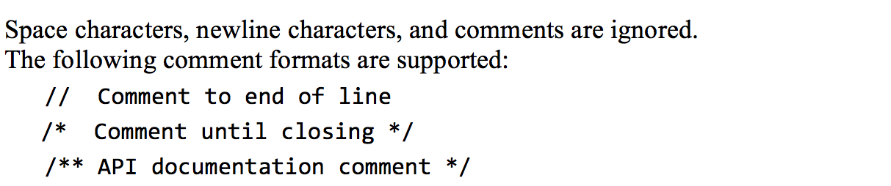
Syntax
/** Procedural processing example */
class Main {
/* Inputs numbers and computes their average */
function void main() {
var Array a;
var int length;
var int i, sum;
let length = Keyboard.readInt("How many numbers? ");
let a = Array.new(length); // constructs the array
let i = 0;
while (i < length) {
let a[i] = Keyboard.readInt("Enter a number: ");
let sum = sum + a[i];
let i = i + 1;
}
...
}
Syntax elements:
White space / comments
keywords
Symbols
Constants
Identifiers

Slide 101
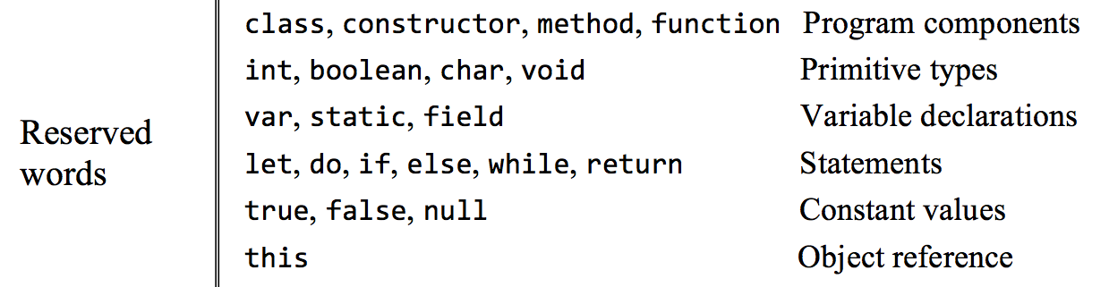
Syntax
/** Procedural processing example */
class Main {
/* Inputs numbers and computes their average */
function void main() {
var Array a;
var int length;
var int i, sum;
let length = Keyboard.readInt("How many numbers? ");
let a = Array.new(length); // constructs the array
let i = 0;
while (i < length) {
let a[i] = Keyboard.readInt("Enter a number: ");
let sum = sum + a[i];
let i = i + 1;
}
...
}
Syntax elements:
White space / comments
keywords
Symbols
Constants
Identifiers

Slide 102
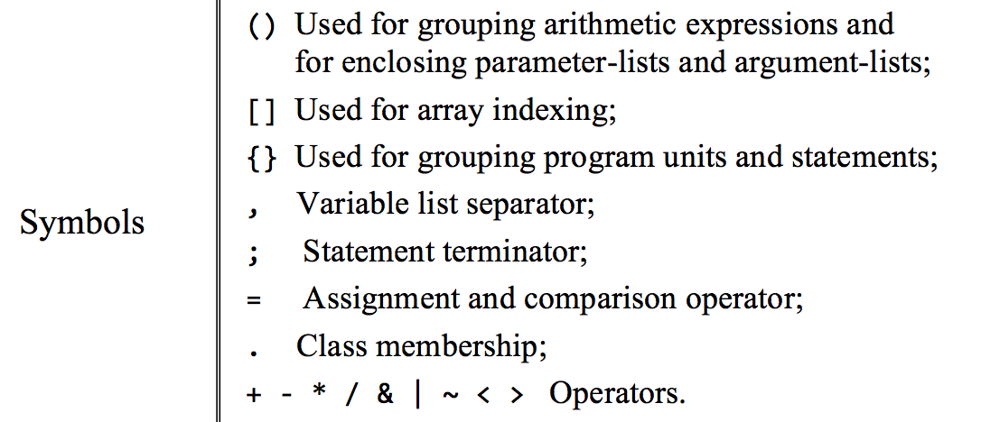
Syntax
/** Procedural processing example */
class Main {
/* Inputs numbers and computes their average */
function void main() {
var Array a;
var int length;
var int i, sum;
let length = Keyboard.readInt("How many numbers? ");
let a = Array.new(length); // constructs the array
let i = 0;
while (i < length) {
let a[i] = Keyboard.readInt("Enter a number: ");
let sum = sum + a[i];
let i = i + 1;
}
...
}
Syntax elements:
White space / comments
keywords
Symbols
Constants
Identifiers

Slide 103
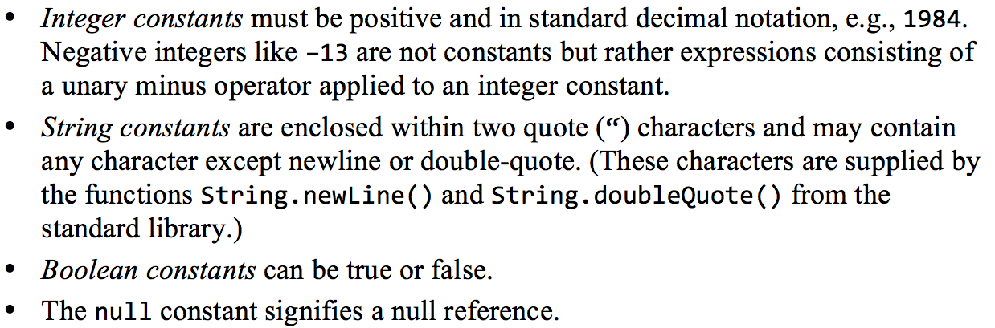
Syntax
/** Procedural processing example */
class Main {
/* Inputs numbers and computes their average */
function void main() {
var Array a;
var int length;
var int i, sum;
let length = Keyboard.readInt("How many numbers? ");
let a = Array.new(length); // constructs the array
let i = 0;
while (i < length) {
let a[i] = Keyboard.readInt("Enter a number: ");
let sum = sum + a[i];
let i = i + 1;
}
...
}
Syntax elements:
White space / comments
keywords
Symbols
Constants
Identifiers

Slide 104
Syntax
/** Procedural processing example */
class Main {
/* Inputs numbers and computes their average */
function void main() {
var Array a;
var int length;
var int i, sum;
let length = Keyboard.readInt("How many numbers? ");
let a = Array.new(length); // constructs the array
let i = 0;
while (i < length) {
let a[i] = Keyboard.readInt("Enter a number: ");
let sum = sum + a[i];
let i = i + 1;
}
...
}
Syntax elements:
White space / comments
keywords
Symbols
Constants
Identifiers

Slide 105
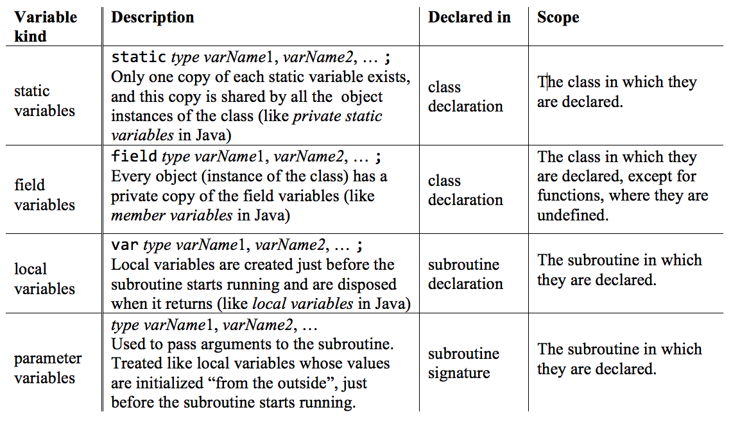
Variables

Slide 106
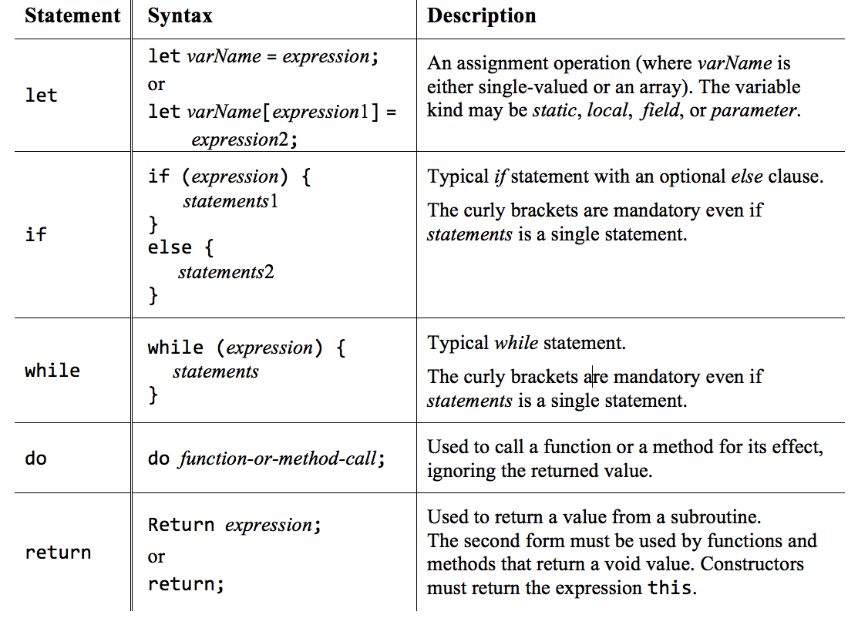
Statements

Slide 107
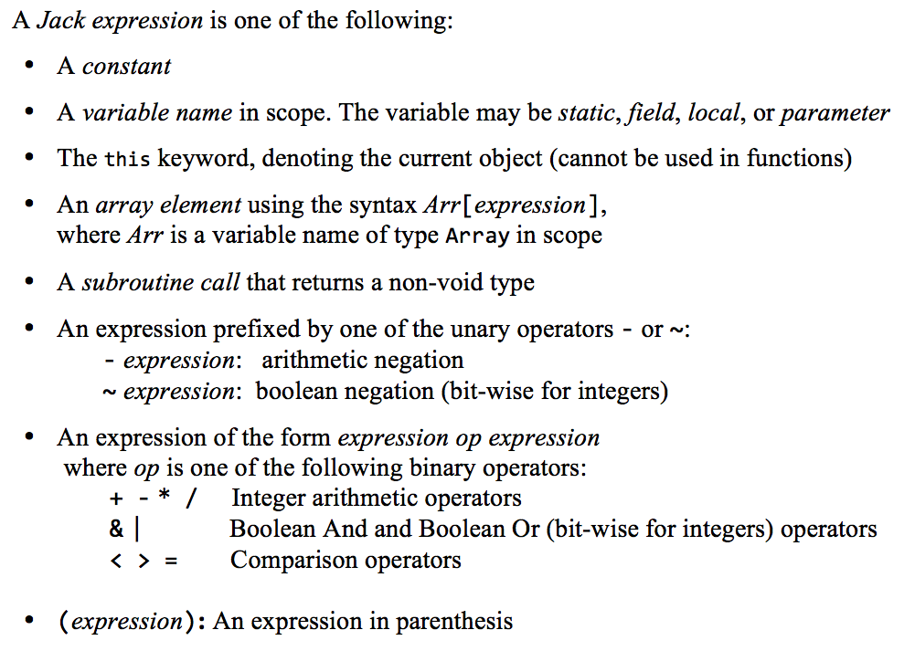
Expressions

Slide 108
Strings
Examples:
...
var String s; // Creates an object variable (pointer), initialized to null
var char c; // Creates a primitive variable, initialized to zero
...
// Sets s to "ABC"
let s = String.new(3);
let s = s.appendChar(65);
let s = s.appendChar(66);
let s = s.appendChar(67);
// Alternatively, the Jack compiler allows:
let s = "ABC";
// Sets c to the “character”, i.e. the numeric value representing 'B'
let c = s.charAt(1);
For more string and character operations, see the String class API.

Slide 109
Arrays
Examples:
...
var Array arr;
var String bla;
let helloWorld = "Hello World!"
...
let arr = Array.new(4);
let arr[0] = 12;
let arr[1] = false;
let arr[2] = Point.new(5,6);
let arr[3] = helloWorld;
...
Jack arrays are ...
instances (objects) of the OS class Array
not typed
A multi-dimensional array is represented as an array of arrays.

Slide 110
The Hack character set
key | code
(space) | 32
! | 33
" | 34
# | 35
$ | 36
% | 37
& | 38
‘ | 39
( | 40
) | 41
* | 42
+ | 43
, | 44
- | 45
. | 46
/ | 47
key | code
0 | 48
1 | 49
… | …
9 | 57
key | code
A | 65
B | 66
C | …
… | …
Z | 90
key | code
a | 97
b | 98
c | 99
… | …
z | 122
key | code
newline | 128
backspace | 129
left arrow | 130
up arrow | 131
right arrow | 132
down arrow | 133
home | 134
end | 135
Page up | 136
Page down | 137
insert | 138
delete | 139
esc | 140
f1 | 141
… | …
f12 | 152
: | 58
; | 59
< | 60
= | 61
> | 62
? | 63
@ | 64
[ | 91
/ | 92
] | 93
^ | 94
_ | 95
` | 96
{ | 123
| | 124
} | 125
~ | 126

Slide 111
Type conversions
Characters and integers can be converted into each other:
var char c;
// Sets c to 'A'
let c = 'A'; // Not supported by the Jack language
let c = 65; // 'A'
// Sets c to 'A' (workaround)
var String s;
let s = "A"; let c = s.charAt(0);
An integer can be assigned to a reference variables, in which case it is treated as a memory address:
var Array arr; // Creates a pointer variable
let arr = 5000; // OK...
let arr[100] = 17; // Sets memory address 5100 to 17
An object can be converted into an array, and vice versa:
var Array arr;
let arr = Array.new(2);
let arr[0] = 2; let arr[1] = 5;
var Point p; // A Point object has two int coordinates
let p = arr; // Sets p to the base address of the memory block representing the array [2,5]
do p.print() // Prints "(2,5)" (using the print method of the Point class)

Slide 112
Classes
Class declaration (stored in Foo.jack)
class Foo {
field variable declarations
static variable declarations
subroutine declarations
}
Jack program = collection of one or more Jack classes
Class = basic compilation unit
Each class Foo is stored in a separate Foo.jack file
The class name’s first character must be an uppercase letter.

Slide 113
Classes
Class declaration (stored in Foo.jack)
class Foo {
field variable declarations
static variable declarations
subroutine declarations
}
Jack program = collection of one or more Jack classes
Class = basic compilation unit
Each class Foo is stored in a separate Foo.jack file
The class name’s first character must be an uppercase letter.

Slide 114
Subroutines
Subroutine declaration
constructor | method | function type subroutineName (parameter-list) {
local variable declarations
statements
}
Jack subroutines
Constructors: create new objects
Methods: operate on the current object
Functions: static methods
Subroutine types and return values
Method and function type can be either void, a primitive data type, or a class name
Each subroutine must end with the statement return value, or return

Slide 115
Subroutine calls
Subroutine call syntax: subroutineName(argument-list)
The number and type of arguments must agree with those of the subroutine’s parameters
Each argument can be an expression of unlimited complexity.
Examples:
class Foo {
...
method void f() {
var Bar b; // Declares a local variable of class type Bar
var int i; // Declares a local variable of primitive type int
...
do g(); // Calls method g of the current class on the this object;
// Note: Cannot be called from within a function (static method)
do Foo.p(3); // Calls function p of the current class;
// Note: A function call must be preceded by the class name
do Bar.h(); // Calls function h of class Bar
let b = Bar.r(); // Calls function or constructor r of class Bar
do b.q(); // Calls method q of class Bar on the b object.
...

Slide 116
End note: Some particular features of the Jack language
The keyword let: Must be used in assignments: let x = 0;
The keyword do: Must be used for calling a method or a function outside an expression: do reduce();
The body of a statement must be within curly brackets, even if it contains a single statement: if (a > 0) { return a; } else { return –a; }
All subroutines must end with a return
No operator priority:
The value of this expression is unpredictable: 2 + 3 * 4
To enforce operator priority, use parentheses: 2 + (3 * 4)
The language is weakly typed.
These language features:
Make the life of Jack programmers a bit harder
Make the life of Jack compiler writers much easier.

Slide 117
Lecture plan
High level programming
Program example
Basic language constructs
Object-based programming
List processing
Gives a flavor of the language
Jack language specification
The language
The operating system
To be used as a technical reference
Application development
Jack applications
Application example
Graphics optimization

Slide 118
The Jack OS
Jack code
// Inputs numbers and computes their average
class Main {
function void main() {
var Array a;
var int length;
var int i, sum;
let length = Keyboard.readInt("How many numbers?");
let a = Array.new(length); // constructs the array
let i = 0;
while (i < length) {
let a[i] = Keyboard.readInt("Enter a number:");
let sum = sum + a[i];
let i = i + 1;
}
do Output.printString("The average is ");
do Output.printInt(sum / length);
return;
}
}
Like other modern programming languages (Java, Python, C#, ...), Jack is a simple language
What makes Jack powerful is an open-ended standard class library
The standard class library can be seen as a language-specific OS.

Slide 119
The Jack OS
Jack code
// Inputs numbers and computes their average
class Main {
function void main() {
var Array a;
var int length;
var int i, sum;
let length = Keyboard.readInt("How many numbers?");
let a = Array.new(length); // constructs the array
let i = 0;
while (i < length) {
let a[i] = Keyboard.readInt("Enter a number:");
let sum = sum + a[i];
let i = i + 1;
}
do Output.printString("The average is ");
do Output.printInt(sum / length);
return;
}
}
Jack OS
A collection of supplied Jack classes
Similar to Java’s standard class library.
How many numbers? 3
Enter a number: 12
Enter a number: 8
Enter a number: 5
The average is 8
Purpose:
Closes gaps between high-level programs and the host hardware
Features efficient implementations of:
Commonly-used functions
Commonly-used ADTs.

Slide 120
The Jack OS
OS classes:
Math: Common mathematical operations
String: Common string processing
Array: Used to construct and dispose arrays
Output: Handles textual output
Screen: Handles graphical output
Keyboard: Handles input
Memory: Memory management services
Sys: Execution relates services
Two views on the OS
Abstraction (API):
How to use the OS
Implementation:
How to build the OS
this lecture
chapter 12
Complete OS API: book / website

Slide 121
The Jack OS
OS classes:
Math: Common mathematical operations
String: Common string processing
Array: Used to construct and dispose arrays
Output: Handles textual output
Screen: Handles graphical output
Keyboard: Handles input
Memory: Memory management services
Sys: Execution relates services
class Math {
function int abs(int x)
function int multiply(int x, int y)
function int divide(int x, int y)
function int min(int x, int y)
function int max(int x, int y)
function int sqrt(int x)
}
Usage example:
// Sets b to true
boolean b;
let b = (x = Math.sqrt(Math.multiply(x,x)));
...
Complete OS API: book / website

Slide 122
The Jack OS
OS classes:
Math: Common mathematical operations
String: Common string processing
Array: Used to construct and dispose arrays
Output: Handles textual output
Screen: Handles graphical output
Keyboard: Handles input
Memory: Memory management services
Sys: Execution relates services
Class String {
constructor String new(int maxLength)
method void dispose()
method int length()
method char charAt(int j)
method void setCharAt(int j, char c)
method String appendChar(char c)
method void eraseLastChar()
method int intValue()
method void setInt(int j)
function char backSpace()
function char doubleQuote()
function char newLine()
}
Complete OS API: book / website
Usage example:
// Gets the last character in the string
let c = str.charAt(str.length() – 1);
...

Slide 123
The Jack OS
OS classes:
Math: Common mathematical operations
String: Common string processing
Array: Used to construct and dispose arrays
Output: Handles textual output
Screen: Handles graphical output
Keyboard: Handles input
Memory: Memory management services
Sys: Execution relates services
Class Array {
function Array new(int size)
method void dispose()
}
Usage example:
// Defines an array of 10 elements
// (Jack arrays are untyped)
Array arr;
let arr = Array.new(10);
...
Complete OS API: book / website

Slide 124
The Jack OS
OS classes:
Math: Common mathematical operations
String: Common string processing
Array: Used to construct and dispose arrays
Output: Handles textual output
Screen: Handles graphical output
Keyboard: Handles input
Memory: Memory management services
Sys: Execution relates services
class Output {
function void moveCursor(int i, int j)
function void printChar(char c)
function void printString(String s)
function void printInt(int i)
function void println()
function void backSpace()
}
Screen: 23 rows of 64 characters, black and white
Font: implemented by the OS print methods
Usage example:
Complete OS API: book / website
// (Note: the ASCII code of the character a is 97)
// Prints 97, then prints the character a, twice
do Output.printInt(97);
do Output.printChar(97);
do Output.printString("a");
...

Slide 125
The Jack OS
OS classes:
Math: Common mathematical operations
String: Common string processing
Array: Used to construct and dispose arrays
Output: Handles textual output
Screen: Handles graphical output
Keyboard: Handles input
Memory: Memory management services
Sys: Execution relates services
Class Screen {
function void clearScreen()
function void setColor(boolean b)
function void drawPixel(int x, int y)
function void drawLine(int x1, int y1, int x2, int y2)
function void drawRectangle(int x1, int y1, int x2, int y2)
function void drawCircle(int x, int y, int r)
}
Screen: 256 rows of 512 pixels,
black and white
Complete OS API: book / website
Usage example:
// Draws a circle of radius 50 centered at (100,100)
// using the current color
do Screen.drawCircle(100,100,50);
...

Slide 126
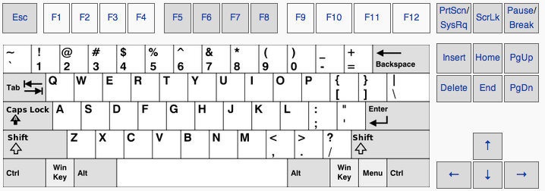
The Jack OS
OS classes:
Math: Common mathematical operations
String: Common string processing
Array: Used to construct and dispose arrays
Output: Handles textual output
Screen: Handles graphical output
Keyboard: Handles input
Memory: Memory management services
Sys: Execution relates services
Class Keyboard {
function char keyPressed()
function char readChar()
function String readLine(String message)
function int readInt(String message)
}
(Reads data from the standard keyboard)
Complete OS API: book / website
Usage example:
...
let age = Keyboard.readInt("enter your age: ");
...

Slide 127
The Jack OS
OS classes:
Math: Common mathematical operations
String: Common string processing
Array: Used to construct and dispose arrays
Output: Handles textual output
Screen: Handles graphical output
Keyboard: Handles input
Memory: Memory management services
Sys: Execution relates services
class Memory {
function int peek(int address)
function void poke(int address,
int value)
function Array alloc(int size)
function void deAlloc(Array o)
}
Usage example:
// Sets RAM[257] to RAM[256]
do Memory.poke(257,Memory.peek(256));
...
Complete OS API: book / website

Slide 128
The Jack OS
OS classes:
Math: Common mathematical operations
String: Common string processing
Array: Used to construct and dispose arrays
Output: Handles textual output
Screen: Handles graphical output
Keyboard: Handles input
Memory: Memory management services
Sys: Execution relates services
Class Sys {
function void halt():
function void error(int errorCode)
function void wait(int duration)
}
Usage example:
// Pauses for one second (1000 milliseconds)
do Sys.wait(1000);
...
Complete OS API: book / website

Slide 129
The Jack OS
OS classes:
Math: Common mathematical operations
String: Common string processing
Array: Used to construct and dispose arrays
Output: Handles textual output
Screen: Handles graphical output
Keyboard: Handles input
Memory: Memory management services
Sys: Execution relates services
Complete OS API: book / website

Slide 130
Lecture plan
High level programming
Program example
Basic language constructs
Object-based programming
List processing
Jack language specification
The language
The operating system
Application development
Jack applications
Application example
Graphics optimization
Relevant to project 9

Slide 131
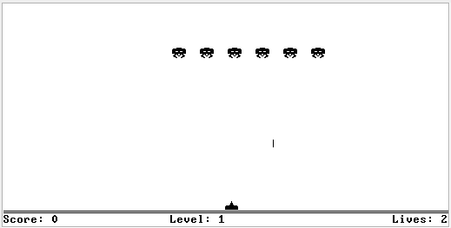
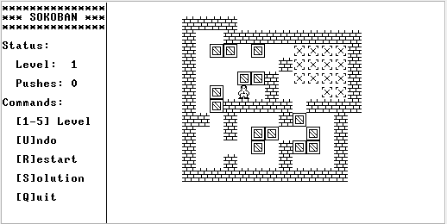
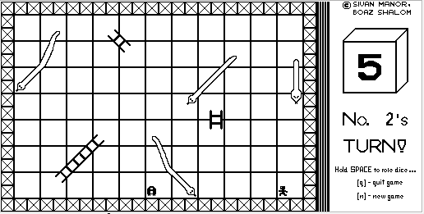
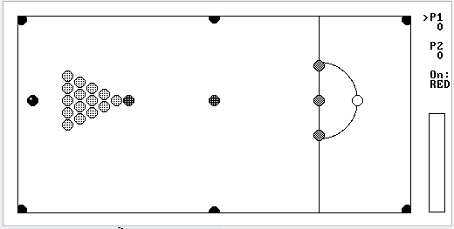
Sample Jack applications
More examples: See the “cool stuff” section in www.nand2tetris.org

Slide 132
Sample Jack applications
Square: A simple, interactive, multi-class OO application
Pong: A complete, interactive, multi-class OO application
Average: Illustrates simple array processing
ComplexArrays: Illustrates various array manipulations, including two-dimensional arrays
ConvertToBin: Illustrates algebraic operations, and working with peek and poke
The source code of these programs is available in nand2tetris/projects/11
These programs contain various programming tricks that may help you develop your own game in Project 9.

Slide 133
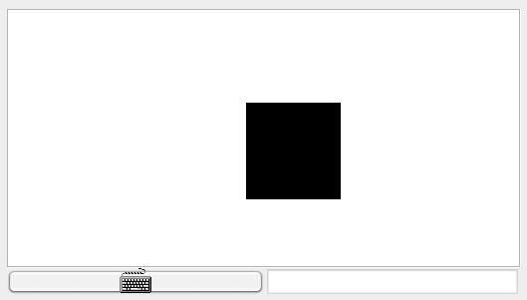
Application example: Square Dance
Purpose: Learning...
OO design
How to design / build an interactive application
How to implement graphical objects and animation
How to use the Jack OS

Slide 134
Application example: Square Dance
When the game starts, a black square appears at the top left of the screen.

Slide 135
Application example: Square Dance
Usage
up arrow: the square starts moving up, until another key is pressed
down arrow: the square starts moving down, until another key is pressed
left arrow: the square starts moving left, until another key is pressed
right arrow: the square starts moving right, until another key is pressed
x key: the square’s size increases a little (2 pixels)
z key: the square’s size decreases a little (2 pixels)
q: game over.

Slide 136
Application example: Square Dance
Design: 3 Jack classes:
Square: Represents a graphical Square object
SquareGame: Creates a Square, then enters a loop that captures the user’s input and moves / resizes / the square or quits, accordingly
Main: Creates a SquareGame, and launches the game.

Slide 137
Square class
Square API
/** Implements a graphical square. */
class Square {
/** Constructs a new square with a given location and size */
constructor Square new(int Ax, int Ay, int Asize)
/** Disposes this square */
method void dispose()
/** Draws this square on the screen */
method void draw()
/** Erases this square from the screen */
method void erase()
/** Increments this square’s size by 2 pixels */
method void incSize()
/** Decrements this square’s size by 2 pixels */
method void decSize()
/** Moves this square up by 2 pixels */
method void moveUp()
/** Moves this square down by 2 pixels */
method void moveDown()
/** Moves this square left by 2 pixels */
method void moveLeft()
/** Moves this square right by 2 pixels */
method void moveRight()
}
x
(0,0)
y
size

Slide 138
Square class
Square.jack
/** Implements a graphical square. */
class Square {
field int x, y; // screen location of the square's top-left corner
field int size; // length of this square, in pixels
x
(0,0)
y
size

Slide 139
Square class
Square.jack
/** Implements a graphical square. */
class Square {
field int x, y; // screen location of the square's top-left corner
field int size; // length of this square, in pixels
...
/** Draws the square on the screen. */
method void draw() {
do Screen.setColor(true);
do Screen.drawRectangle(x, y, x + size, y + size);
return;
}
/** Erases the square from the screen. */
method void erase() {
do Screen.setColor(false);
do Screen.drawRectangle(x, y, x + size, y + size);
return;
}
...
x
(0,0)
y
size

Slide 140
Square class
Square.jack
/** Implements a graphical square. */
class Square {
field int x, y; // screen location of the square's top-left corner
field int size; // length of this square, in pixels
...
/** Increments the square size by 2 pixels. */
method void incSize() {
if (((y + size) < 254) & ((x + size) < 510)) {
do erase();
let size = size + 2;
do draw();
}
return;
}
/** Decrements the square size by 2 pixels. */
method void decSize() {
if (size > 2) {
do erase();
let size = size - 2;
do draw();
}
return;
}
...
x
(0,0)
y
size

Slide 141
Square class
Square.jack
/** Implements a graphical square. */
class Square {
field int x, y; // screen location of the square's top-left corner
field int size; // length of this square, in pixels
...
/** Moves the square up by 2 pixels. */
method void moveUp() {
if (y > 1) {
do Screen.setColor(false);
do Screen.drawRectangle(x, (y + size) - 1, x + size, y + size);
let y = y - 2;
do Screen.setColor(true);
do Screen.drawRectangle(x, y, x + size, y + 1);
}
return;
}
method void moveDown() { // similar }
method void moveLeft() { // similar }
method void moveRight() { // similar }
} // class Square
x
(0,0)
y
size

Slide 142
Application example: Square Dance
Design: 3 Jack classes:
Square: Represents a Square object
SquareGame: Creates a Square, then enters a loop that captures the user’s input and moves the square / resizes / quits accordingly
Main: Creates a SquareGame, and launches the game.

Slide 143
SquareGame class
SquareGame.jack
/** Implements a square game. */
class SquareGame {
field Square square; // the square of this game
field int direction; // the square’s current direction:
// 0=none, 1=up, 2=down, 3=left, 4=right
x
(0,0)
y
size

Slide 144
SquareGame class
SquareGame.jack
/** Implements a square game. */
class SquareGame {
field Square square; // the square of this game
field int direction; // the square’s current direction:
// 0=none, 1=up, 2=down, 3=left, 4=right
/** Constructs a new Square Game. */
constructor SquareGame new() {
let square = Square.new(0, 0, 30);
let direction = 0;
return this;
}
/** Disposes this game. */
method void dispose() {
do square.dispose();
do Memory.deAlloc(this);
return;
}
/** Moves the square in the current direction. */
method void moveSquare() {
if (direction = 1) { do square.moveUp(); }
if (direction = 2) { do square.moveDown(); }
if (direction = 3) { do square.moveLeft(); }
if (direction = 4) { do square.moveRight(); }
do Sys.wait(5); // delays the next movement
return;
}
...
x
(0,0)
y
size

Slide 145
SquareGame class
SquareGame.jack
/** Implements a square game. */
class SquareGame {
field Square square; // the square of this game
field int direction; // the square’s current direction:
// 0=none, 1=up, 2=down, 3=left, 4=right
/** Runs the game: handles the user’s inputs and moves the square accordingly */
method void run() {
var char key; // the key currently pressed by the user
var boolean exit;
let exit = false;
while (~exit) {
// waits for a key to be pressed
while (key = 0) {
let key = Keyboard.keyPressed();
do moveSquare();
}
if (key = 81) { let exit = true; } // q key
if (key = 90) { do square.decSize(); } // z key
if (key = 88) { do square.incSize(); } // x key
if (key = 131) { let direction = 1; } // up arrow
if (key = 133) { let direction = 2; } // down arrow
if (key = 130) { let direction = 3; } // left arrow
if (key = 132) { let direction = 4; } // right arrow
// waits for the key to be released
while (~(key = 0)) {
let key = Keyboard.keyPressed();
do moveSquare();
}
} // while
return;
}
} // SquareGame class
typical handling of “keyboard events” in interactive Jack apps
x
(0,0)
y
size

Slide 146
Application example: Square Dance
Design: 3 Jack classes:
Square: Represents a Square object
SquareGame: Creates a Square, then enters a loop that captures the user’s input and moves the square / resizes / quits accordingly
Main: Creates a SquareGame, and launches the game.

Slide 147
Application example: Square Dance
Main.jack
/** Main class of the Square Dance game. */
class Main {
/** Initializes a new game and starts it. */
function void main() {
var SquareGame game;
let game = SquareGame.new();
do game.run();
do game.dispose();
return;
}
}
Design: 3 Jack classes:
Square: Represents a Square object
SquareGame: Creates a Square, then enters a loop that captures the user’s input and moves the square / resizes / quits accordingly
Main: Creates a SquareGame, and launches the game.

Slide 148
Lecture plan
High level programming
Program example
Basic language constructs
Object-based programming
List processing
Gives a flavor of the language
Jack language specification
The language
The operating system
To be used as a technical reference
Application development
Jack applications
Application example
Graphics optimization

Slide 149
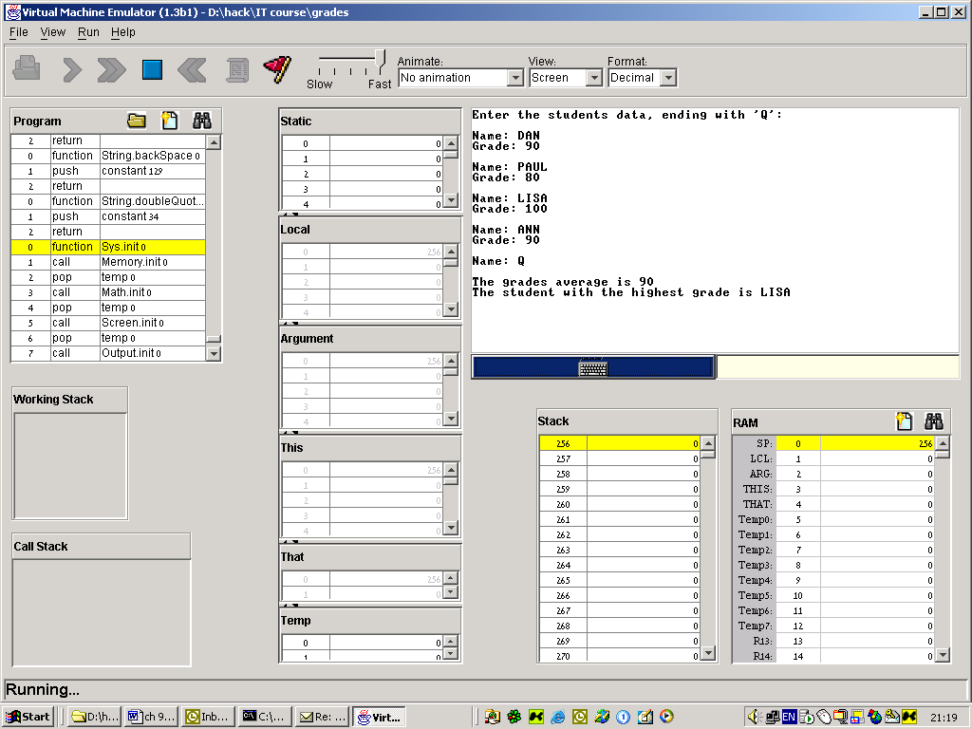
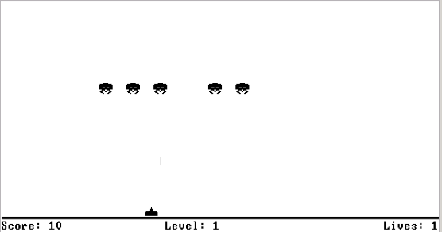
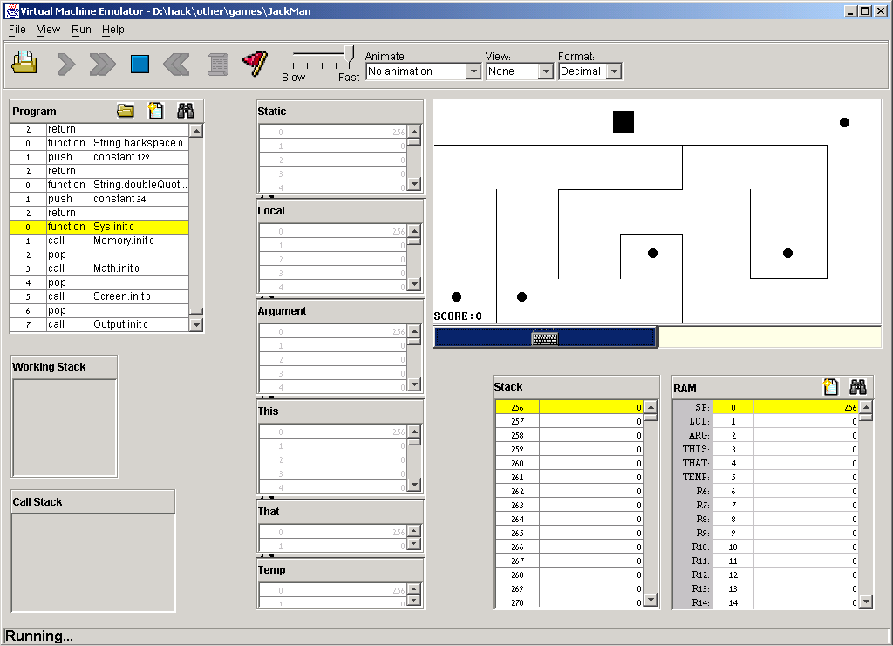
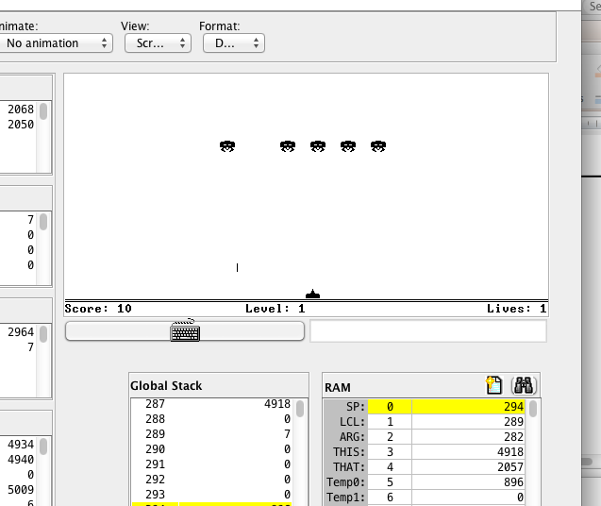
Sprites
Space Invaders (by Ran Navok)
Basic graphical elements
(sprites):

Slide 150
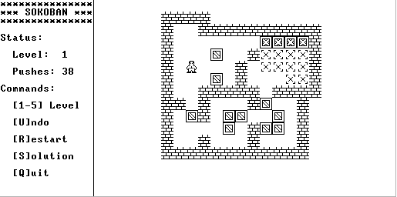
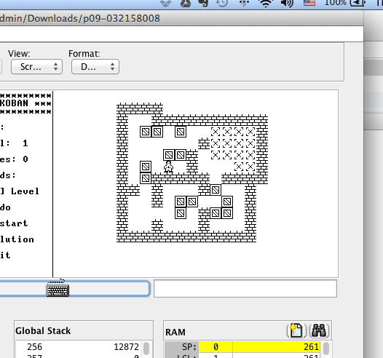
Sprites
Sokoban (by Golan Parashi)
Basic graphical elements
(sprites):

Slide 151
Sprites
Sprite
A fixed two-dimensional bitmap, typically integrated into a larger scene
Challenges
Drawing sprites quickly
Creating smooth animations
Solutions
Use the standard OS graphics library (may be slow)
Write your own graphics functions (can be fast)

Slide 152


Hack output hardware (revisited)
RAM
0
1
2
...
...
16384
...
...
24575
24576
...
32767
0001100000100100
1111000010100001
...
...
...
1000111100111100
8K screen
memory map
refresh
1 word kb map

Slide 153
Hack output hardware (revisited)
RAM
0
1
2
...
...
16384
...
...
24575
...
...
32767
0001100000100100
1111000010100001
...
...
0000000000000000
...
...
0000000000000000
...
...
1000111100111100
0 1 2 ... 511
0
1
...
255
refresh
8K screen
memory map
Hack screen: 256 rows of 512 pixels each

Slide 154
Hack output hardware (revisited)
RAM
0
1
2
...
...
16384
...
19003
...
24575
...
...
32767
0001100000100100
1111000010100001
...
...
0000000000000000
...
0000000000000000
...
0000000000000000
...
...
1000111100111100
0 1 2 ... 511
0
1
...
255
refresh
8K screen
memory map
Hack screen: 256 rows of 512 pixels each

Slide 155
Hack output hardware (revisited)
RAM
0
1
2
...
...
16384
...
19003
...
24575
...
...
32767
0001100000100100
1111000010100001
...
...
0000000000000000
...
0000000000000111
...
0000000000000000
...
...
1000111100111100
0 1 2 ... 511
0
1
...
255
refresh
...
8K screen
memory map
Hack screen: 256 rows of 512 pixels each

Slide 156
Hack output hardware (revisited)
RAM
0
1
2
...
...
16384
...
19003
...
24575
...
...
32767
0001100000100100
1111000010100001
...
...
0000000000000000
...
1111111111111111
...
0000000000000000
...
...
1000111100111100
0 1 2 ... 511
0
1
...
255
refresh
................
8K screen
memory map
Hack screen: 256 rows of 512 pixels each

Slide 157
Hack output hardware (revisited)
RAM
0
1
2
...
...
16384
...
19003
...
24575
...
...
32767
0001100000100100
1111000010100001
...
...
0000000000000000
...
1010101010101010
...
0000000000000000
...
...
1000111100111100
0 1 2 ... 511
0
1
...
255
refresh
................
8K screen
memory map
Hack screen: 256 rows of 512 pixels each

Slide 158
Hack output hardware (revisited)
RAM
The OS class Memory (API)
0
1
2
...
...
16384
...
19003
...
24575
...
...
32767
0001100000100100
1111000010100001
...
...
0000000000000000
...
1111111111111111
...
0000000000000000
...
...
1000111100111100
class Memory {
function int peek(int address)
function void poke(int address,
int value)
function Array alloc(int size)
function void deAlloc(Array o)
}
Can be used to “write pixels” directly into the RAM
8K screen
memory map
Example: Drawing a “line” of 16 pixels:
// Sets RAM[19003] to 1111111111111111
do Memory.poke(19003,-1)
Instead of writing bits directly into the memory map, we can use the OS graphics library (Screen)

Slide 159
Standard drawing (may be slow)
The OS class Screen (API)
0 1 2 ... 511
410
Class Screen {
function void clearScreen()
function void setColor(boolean b)
function void drawPixel(int x, int y)
function void drawLine(int x1, int y1, int x2, int y2)
function void drawRectangle(int x1, int y1, int x2, int y2)
function void drawCircle(int x, int y, int r)
}
0
1
...
255
...
...
155

Slide 160
Standard drawing (may be slow)
The OS class Screen (API)
0 1 2 ... 511
410
Class Screen {
function void clearScreen()
function void setColor(boolean b)
function void drawPixel(int x, int y)
function void drawLine(int x1, int y1, int x2, int y2)
function void drawRectangle(int x1, int y1, int x2, int y2)
function void drawCircle(int x, int y, int r)
}
0
1
...
255
...
...
155
Jack code (option 1)
Jack code (option 2)
// draws the image
do Screen.drawPixel(410,155);
do Screen.drawPixel(411,155);
do Screen.drawPixel(412,155);
do Screen.drawPixel(410,156);
do Screen.drawPixel(411,156);
do Screen.drawPixel(412,156);
// draws the image
do Screen.drawLine(410,155,412,155);
do Screen.drawLine(410,156,412,156);
Jack code (option 3)
// draws the image
do Screen.drawRectangle(410,155,412,156);

Slide 161
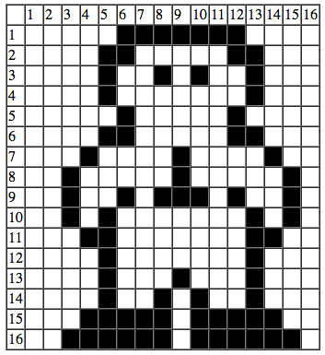
Standard drawing (may be slow)
Image drawing code:
// Draws the top row
do Screen.drawPixel(6,1);
do Screen.drawPixel(7,1);
...
do Screen.drawPixel(12,1);
...
// Draws the bottom row
do Screen.drawPixel(3,16);
...
do Screen.drawPixel(15,16);
Efficiency:
75 pixel drawing operations
OS implementation of drawPixel(x,y)
// sets pixel (x,y) to black / white:
address = 32 * y + x / 16
value = Memory.peek[16384 + address]
set the (x % 16)th bit of value to 0 or 1
do Memory.poke(address,value)
More about this in chapter 12 (OS)

Slide 162
Standard drawing (may be slow)
Image drawing code:
// Draws the top row
do Screen.drawPixel(6,1);
do Screen.drawPixel(7,1);
...
do Screen.drawPixel(12,1);
...
// Draws the bottom row
do Screen.drawPixel(3,16);
...
do Screen.drawPixel(15,16);
Efficiency:
75 pixel drawing operations
Can we do better?

Slide 163
Custom drawing (optimized)
0000111111100000 = 4064
0001100000110000 = 6192
0001001010010000 = 4752
...
...
0111111011111100 = 32508

Slide 164
Custom drawing (optimized)
Image drawing code:
4064
6192
4752
...
...
32508
// Draws the sprite
do Memory.poke(addr0, 4064);
do Memory.poke(addr1, 6192);
do Memory.poke(addr2, 4752);
...
do Memory.poke(addr15,32508);
Efficiency:
16 memory write operations
We still have to compute:
addr0, addr1, …, addr15 (as a function of x, y)

Slide 165
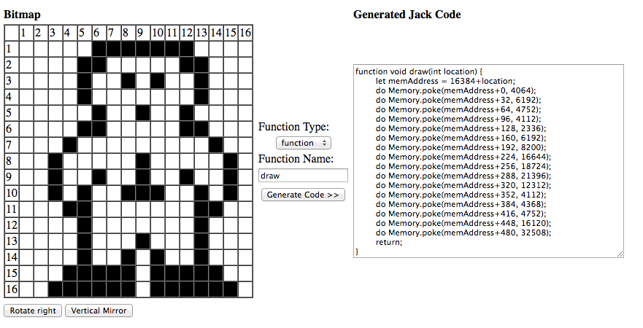
Bitmap editor
1. Draw the image in the editor (easy)
2. Plug the resulting code into your Jack program
Developed by Golan Parashi (available in nand2tetris/projects/09)
Best Practice:
For simple graphics, use the OS library Screen
For high-performance sprites, use the bitmap editor, and Memory.poke

Slide 166
Perspective
Jack is a simple language,
Featuring essential elements of:
Procedural programming
OO programming
Limitations
Few control structures
Some peculiar syntax
No inheritance
Motivation: a minimal language that can be implemented by a simple compiler
Data types
Primitive type system
Weakly typed
Motivation: to give the programmer full control, especially for writing the OS.

Slide 167
Chapter 9
High Level Language

